Slide 1

and infrastructure as code
workshop
Andreas Mosti

Slide 2
Key takeaways
Infrastructure as Code
Configuration Management
What can Ansible solve?
What can it not solve?
Enough knowledge to understand the key principles

Slide 3



Dev/Build
Runtime

Slide 4
Dev/Build
Runtime

Slide 5
Dev/Build
Runtime

Slide 6
Dev/Build
Runtime

Slide 8
The complexity moves

Slide 9







Slide 10


Slide 11

Site A
Site A Replica
Site B
Site B Replica

Slide 12
Application platforms / runtimes
Permissions
Users
Firewall rules
Config Files
Updates
Running Services
Upgrades

Slide 13


Application platforms / runtimes
Permissions
Users
Firewall rules
Config Files
Updates
Running Services
Upgrades
20

Slide 14


Slide 15
Inconsistent server farms

Slide 16
Platform requirements, «What are we releasing on?»

Slide 17
«We need new environments quickly,
in a reproducible fashion»

Slide 18
Automate the infrastructure

Slide 19
Snowflake vs. Phoenix Servers

Slide 20
Infrastructure as code:

Slide 21
Reproducible Environments

Slide 22
Servers in version control

Slide 23
Configuration management

Slide 24
Explicit process

Slide 25
Safety!

Slide 26
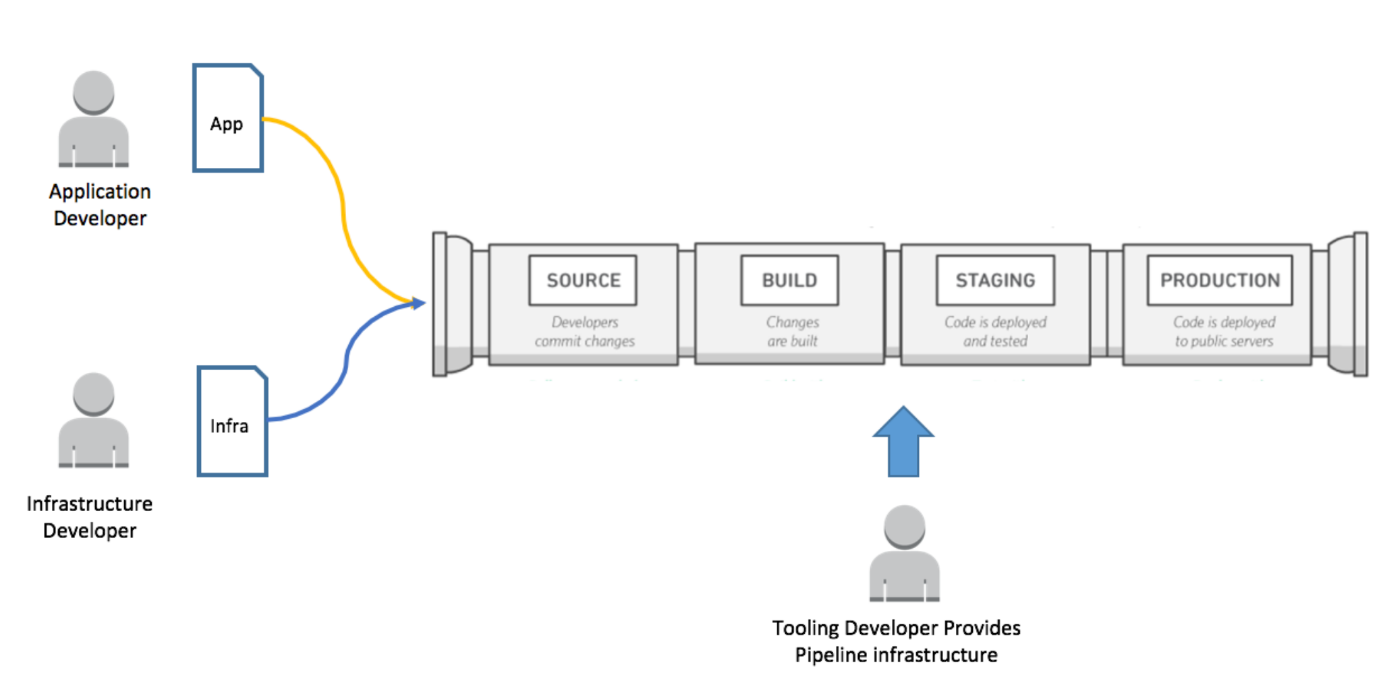
Code Review

Slide 27
Baked vs. Fried servers

Slide 28
The usual suspects

Slide 29





Slide 31
Why Ansible?

Slide 32




Slide 33








Slide 34
Open Source

Slide 35
WinRM
SSH

Slide 36
Most important:

Slide 37
The correct abstraction (for us)

Slide 38
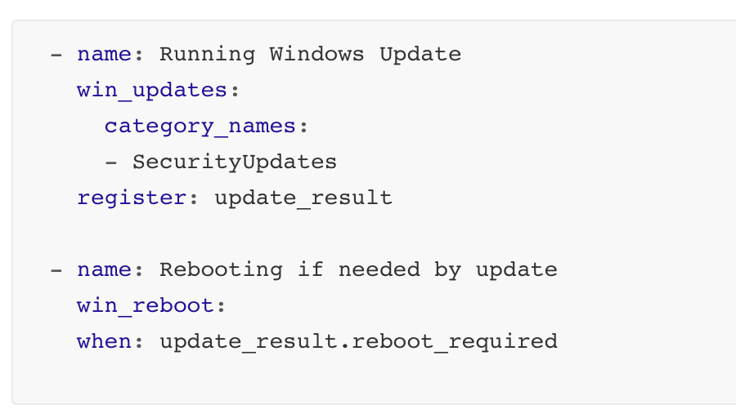

Slide 39


push
Database
Appserver
Playbooks
Load Balancer

Slide 40
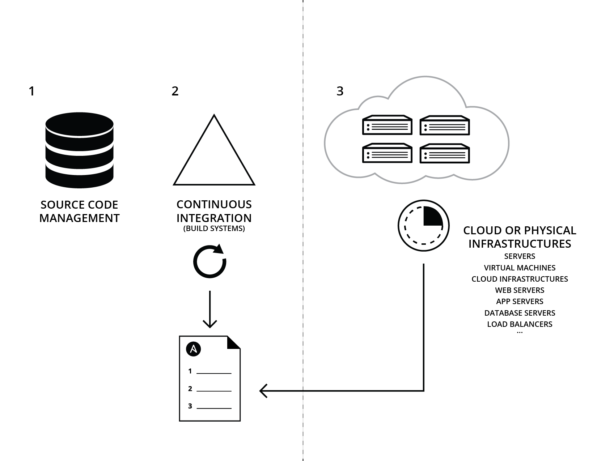

Slide 41
Remember: Ansible keeps state

Slide 42
The benefits of Infrastructure as Code:
Automation
Version control
Code Review
Testing
Documentation
Reuse

Slide 43
The holy grale: Imutable infrastructure

Slide 44
Warning 1:

Slide 45




Slide 48


Slide 49
The files don’t represent reality!

Slide 51
Warning 2:

Slide 52
If not run often,
the system might regress

Slide 53
Part 1: Inventory and connection

Slide 54
WinRM
SSH

Slide 55
WinRM
Port 5986
Local / AD admin user w. remoting
Powershell 3.0
ConfigureRemotingForAnsible.ps1

Slide 56
SSH
Port 22
root / dedicated user(s)

Slide 57
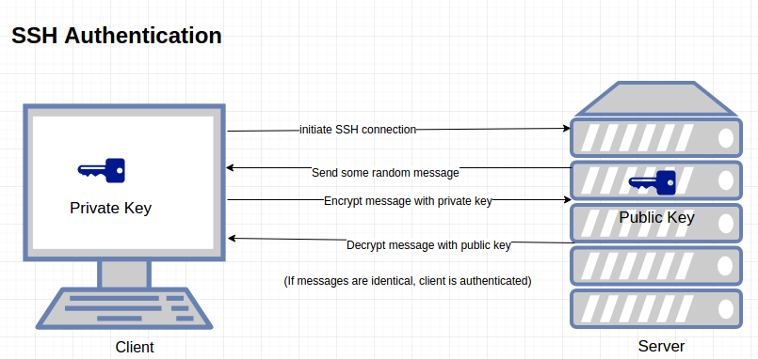

Slide 58
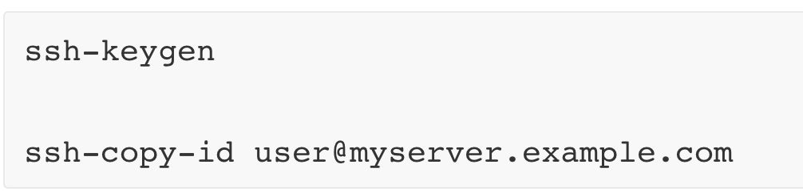

Slide 59
The Inventory

Slide 60
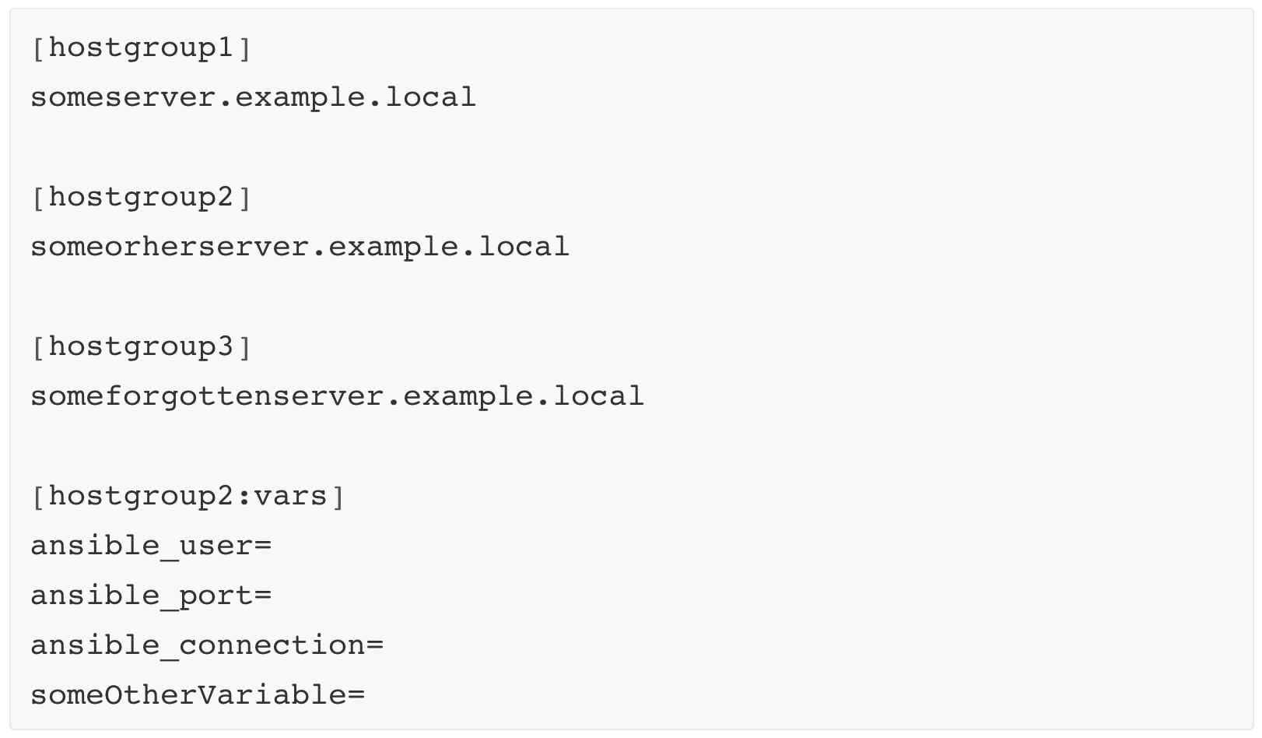
inventory/Example.inventory

Slide 61
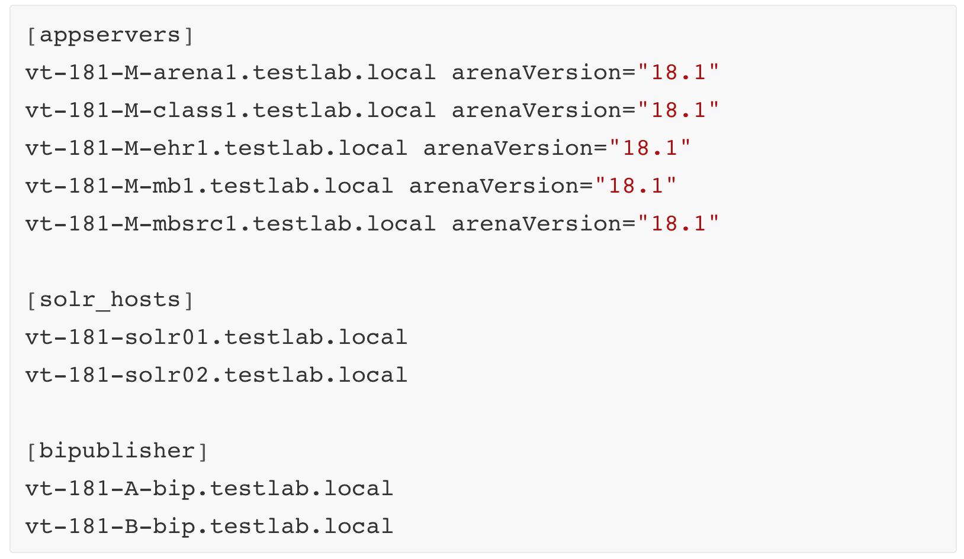
inventory/Testlab18.inventory

Slide 62
Exercise 1: Inventory and server connection

Slide 63
Part 2: Playbooks and tasks

Slide 64
push
Database
Appserver
Playbooks
Loadbalancer

Slide 65




Zookeeper.yaml
Solr.yaml
Database.yaml
ArenaAppServer.yaml
LoadBalancer.yaml

Slide 66
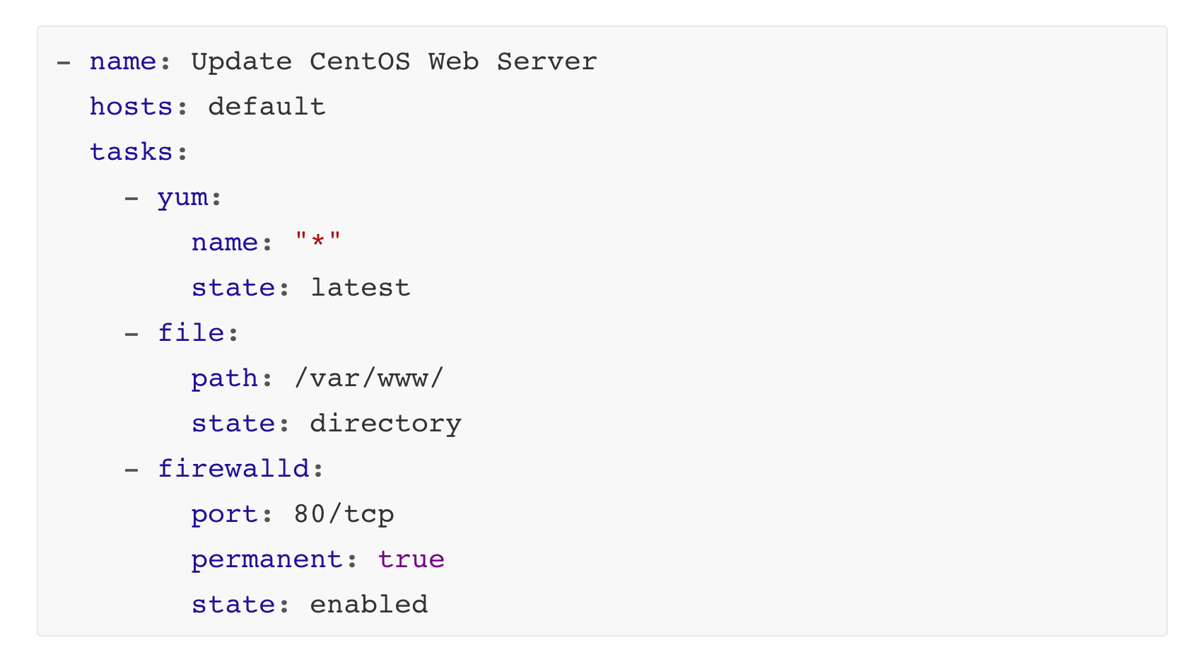
WebServer.yaml

Slide 67
WebServer.yaml

Slide 68
WebServer.yaml

Slide 69
WebServer.yaml

Slide 70
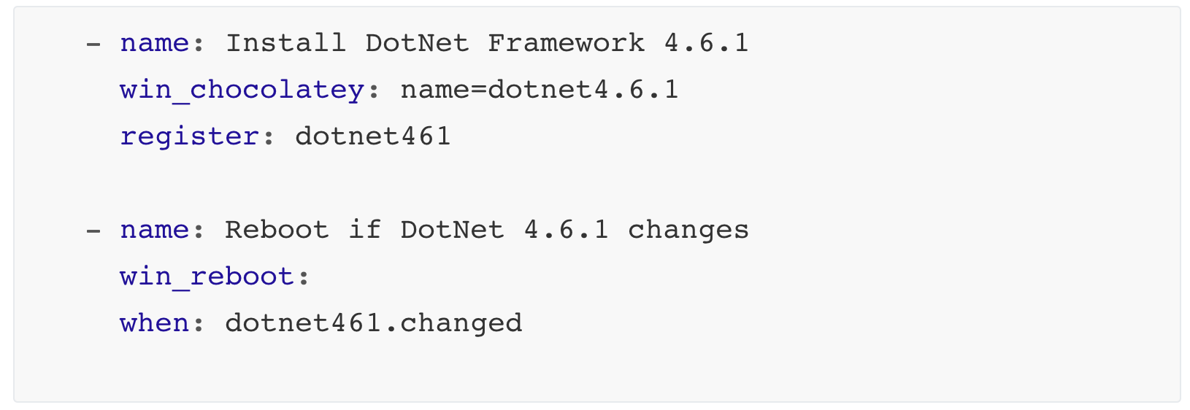
roles/DotNet461/tasks/main.yaml

Slide 72
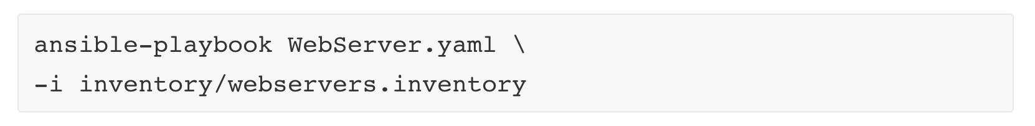

Slide 73
Exercise 2: Playbook and simple tasks

Slide 74
Part 3: Roles and variables

Slide 75
WebServer.yaml

Slide 76
To reuse tasks or implement components, we make roles

Slide 77
Example roles:
IIS
DotnetFramework45
Oracle12C
TeamcityAgent
Java
GoogleChrome
SplunkForwarder

Slide 78
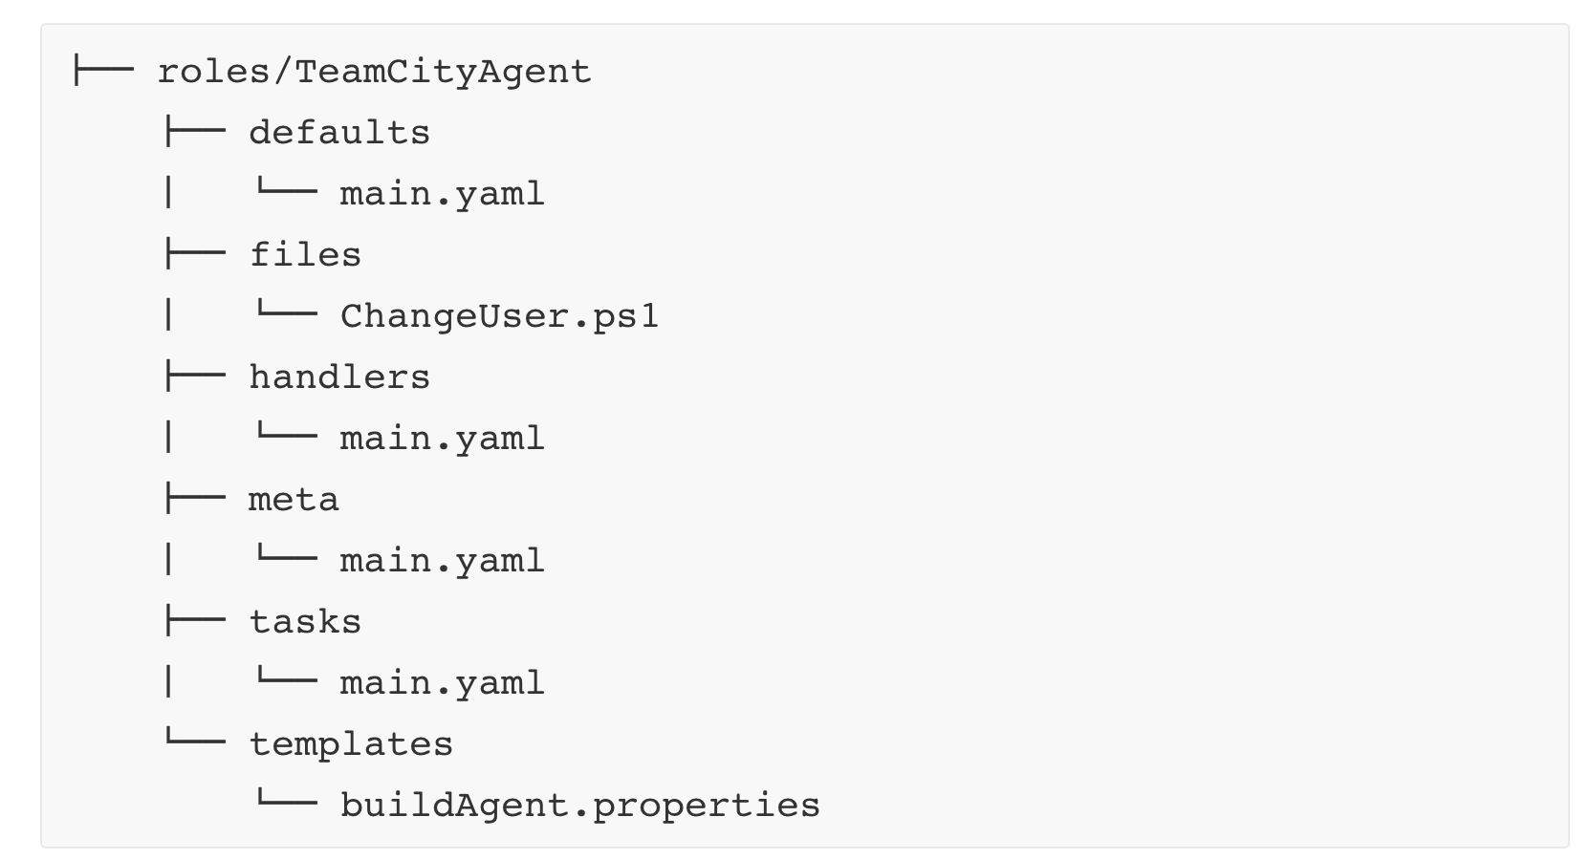

Slide 79
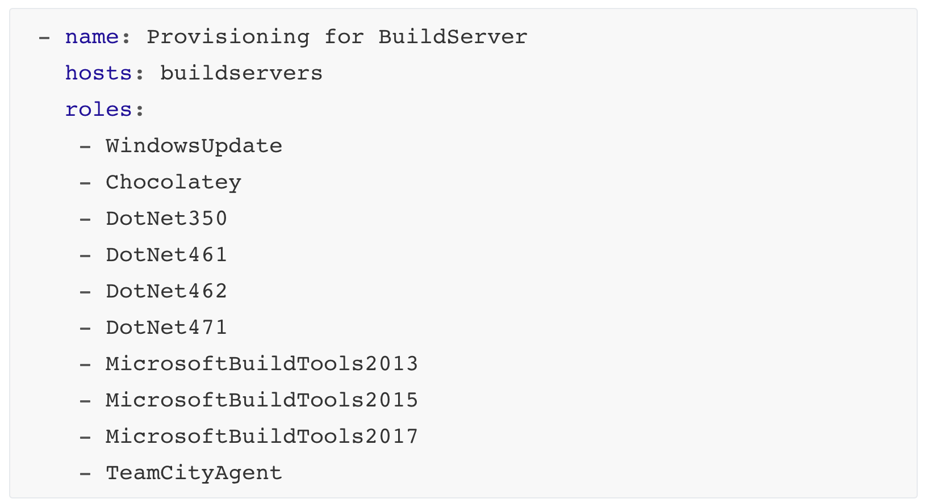
Buildserver.yaml

Slide 80
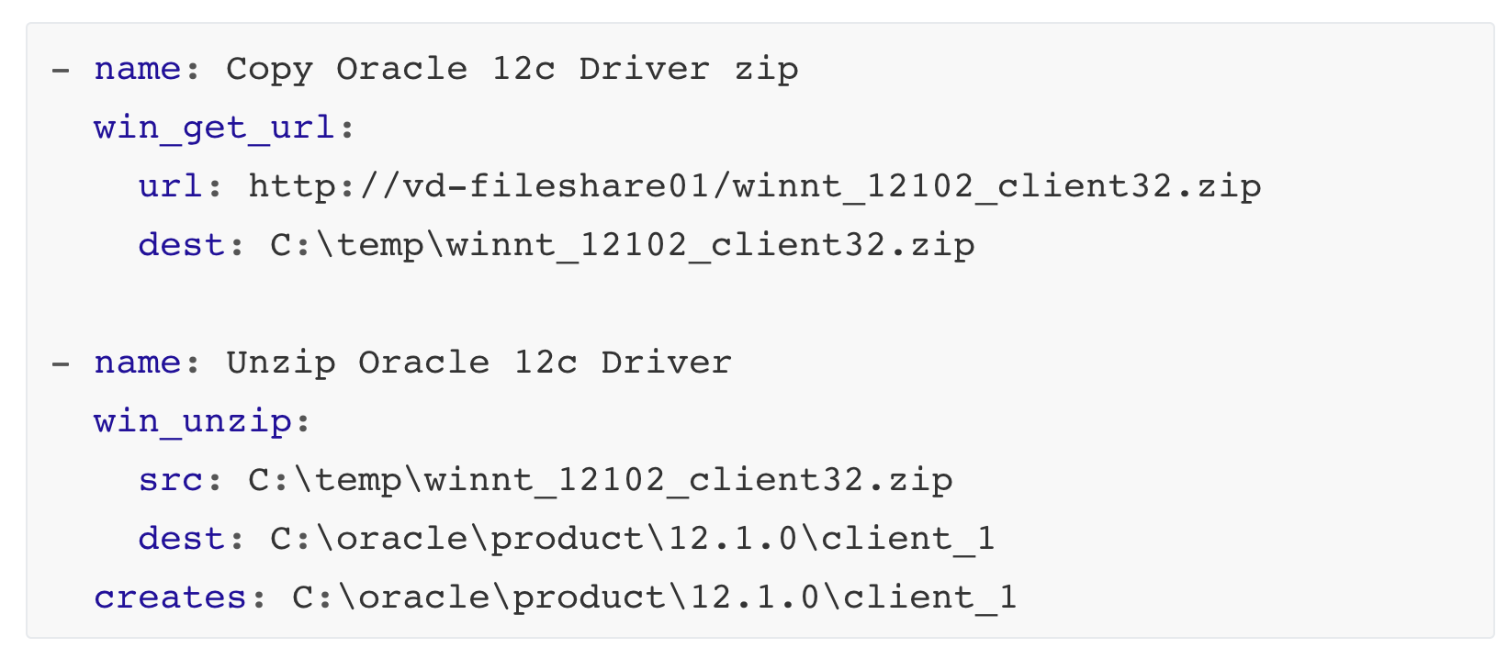
roles/Oracle12Driver/tasks/main.yaml

Slide 81
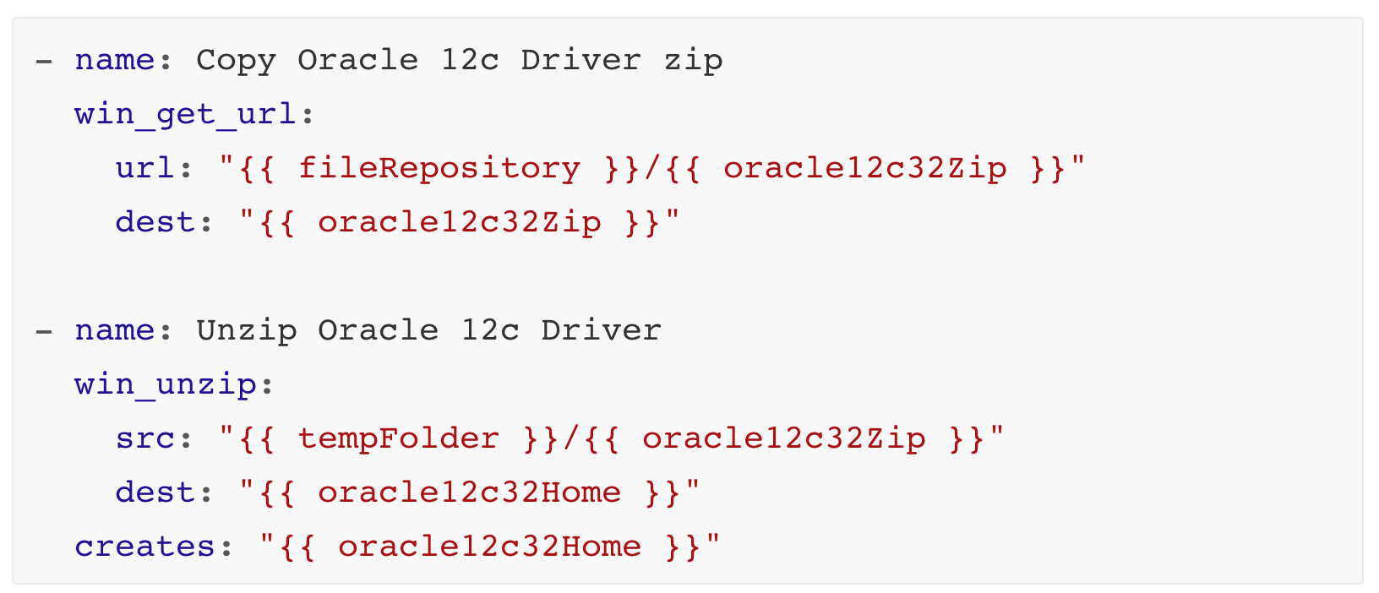
roles/Oracle12Driver/tasks/main.yaml

Slide 82
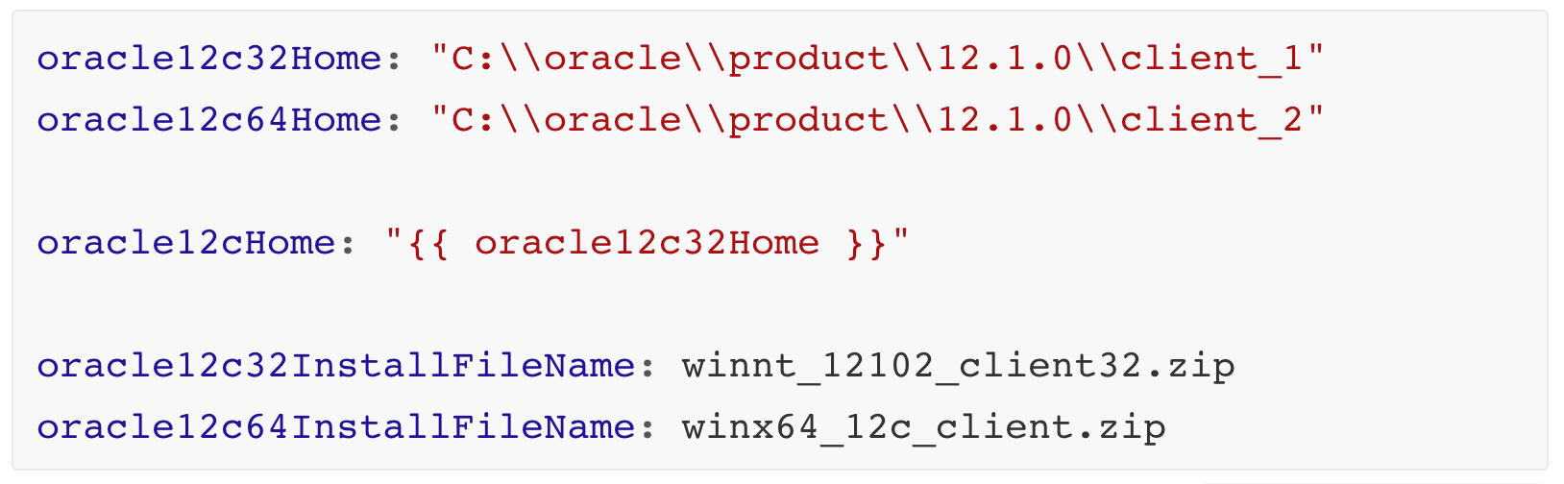
roles/Oracle12Driver/defaults/main.yaml

Slide 83
Lists and iterators

Slide 84
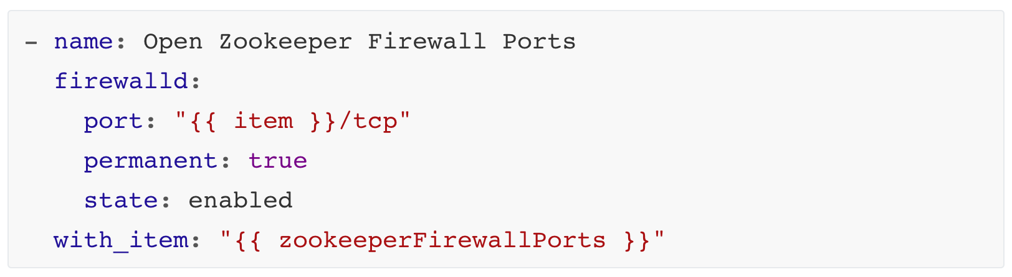
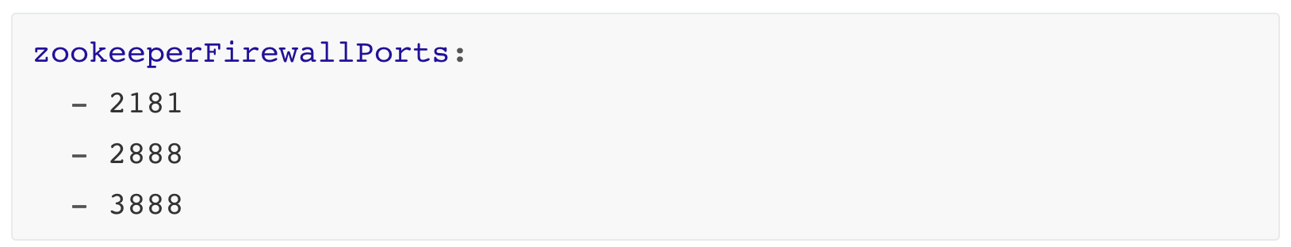
roles/Zookeeper/tasks/main.yaml
roles/Zookeeper/defaults/main.yaml

Slide 85
A word on variable precendence

Slide 86
From least to most important:
role defaults
group_vars/
host_vars/
host facts
play vars
include_vars
set_facts
extra vars

Slide 87
A word on state and idempotency

Slide 88
Always pick modules over shell commands (if possible)

Slide 89
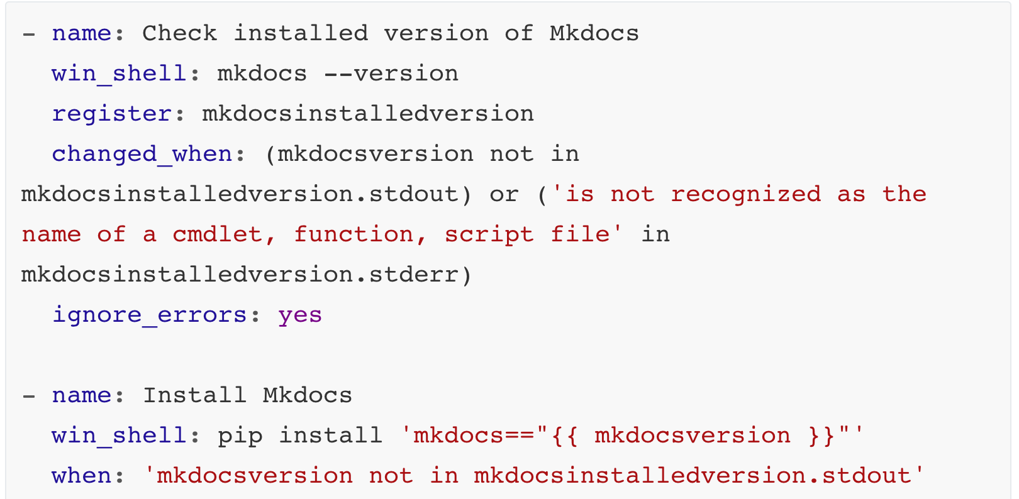
roles/MKDocs/tasks/main.yaml

Slide 90
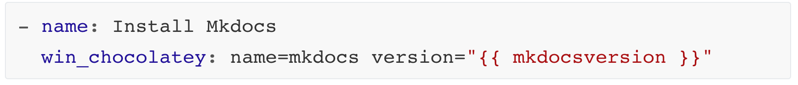
roles/MKDocs/tasks/main.yaml

Slide 91
Exercise 3: Roles, variables and iterators

Slide 92
Part 4: Handlers, templates, files

Slide 94
Files vs Templates

Slide 95
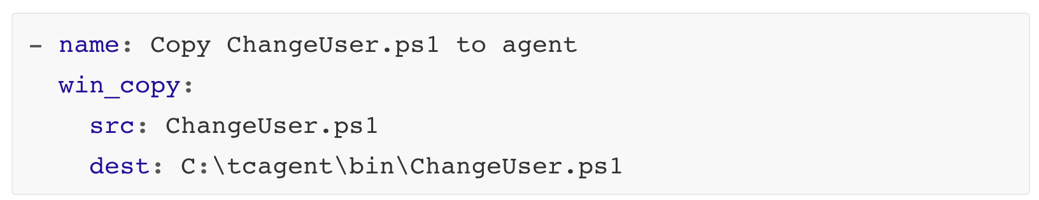
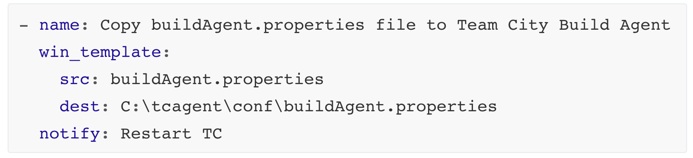
roles/TeamCityAgent/tasks/main.yaml

Slide 96
True configuration management with templating and JINJA2

Slide 97
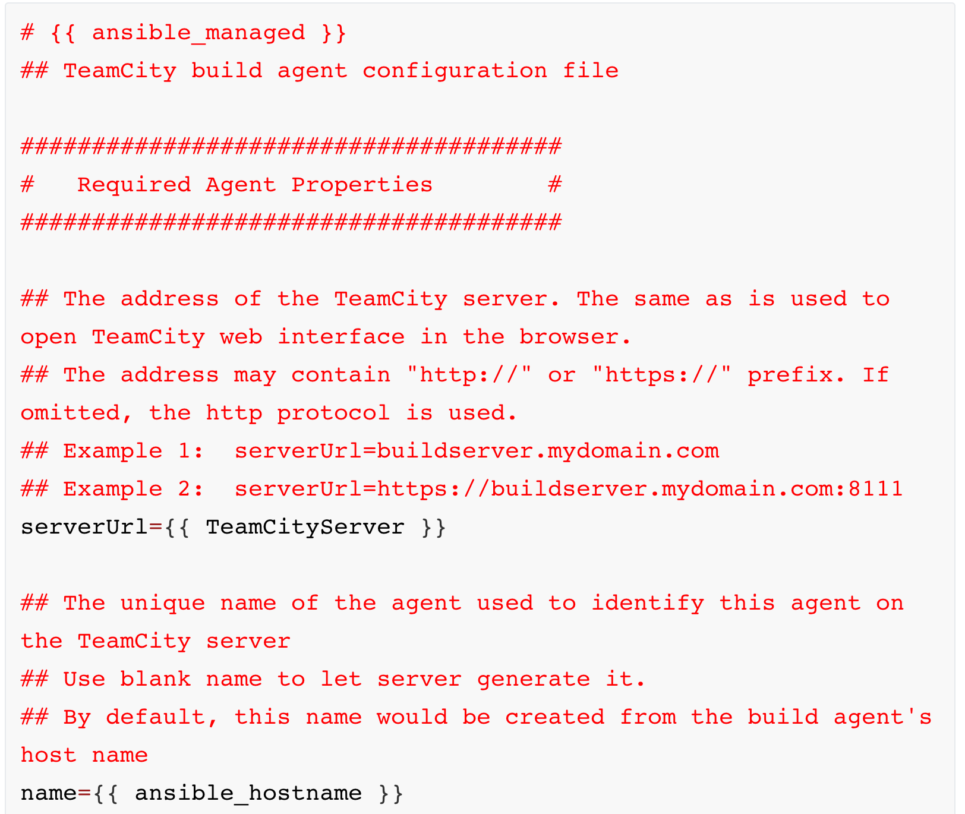
roles/TeamCityAgent/templates/buildAgent.properties

Slide 98
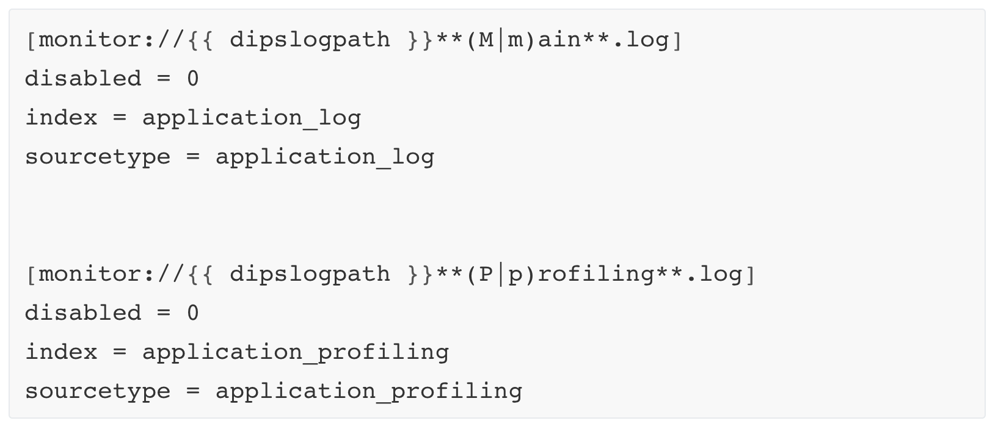
roles/SplunkForwarder/templates/input.conf.j2

Slide 99
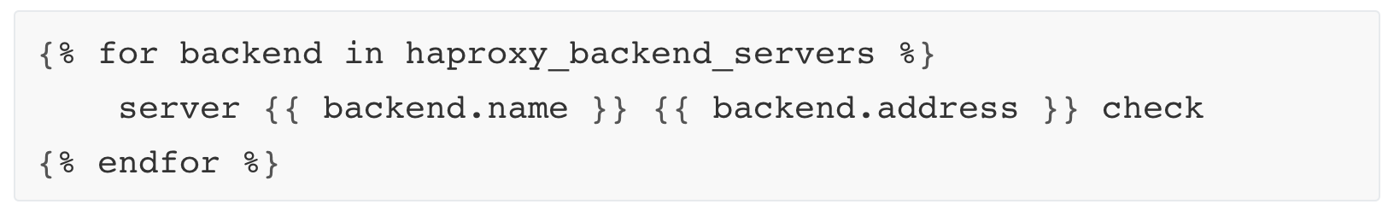
roles/HAProxy/templates/haproxy.conf.j2

Slide 100
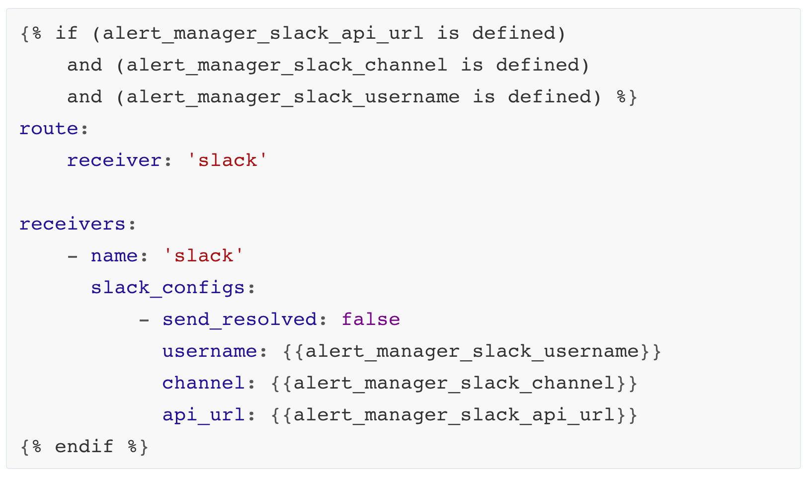
roles/Prometheus/templates/alertmanager.yml.j2

Slide 101
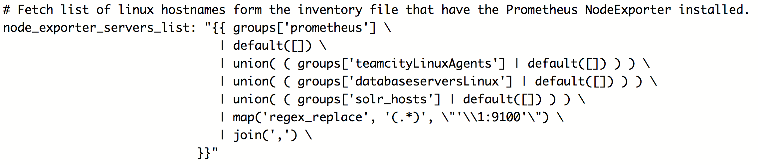
roles/Prometheus/defaults/main.yml

Slide 102
roles/TeamCityAgent/tasks/main.yaml

Slide 103
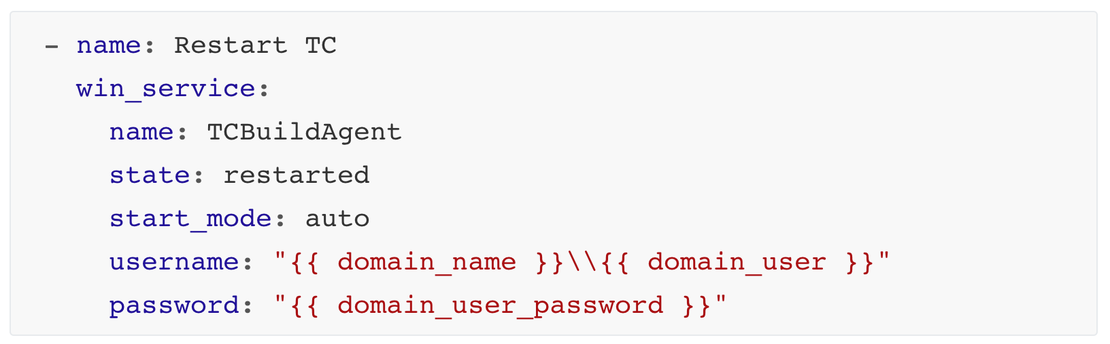
roles/TeamCityAgent/handlers/main.yaml

Slide 104
Exercise 4: Templates, handlers and files

Slide 105
Part 5: Ansible Vault

Slide 106
roles/TeamCityAgent/tasks/main.yaml
When working with secrets

Slide 107
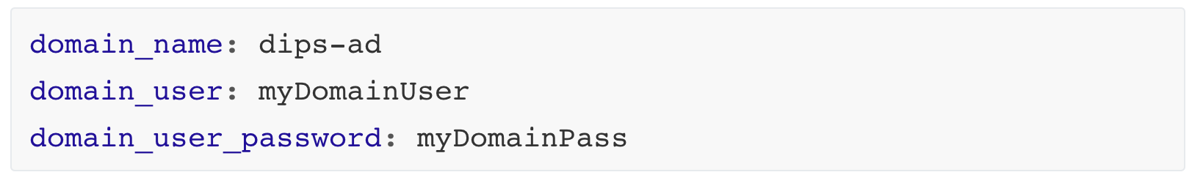
roles/TeamCityAgent/defaults/main.yaml

Slide 108
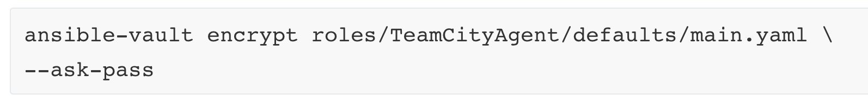

Slide 109
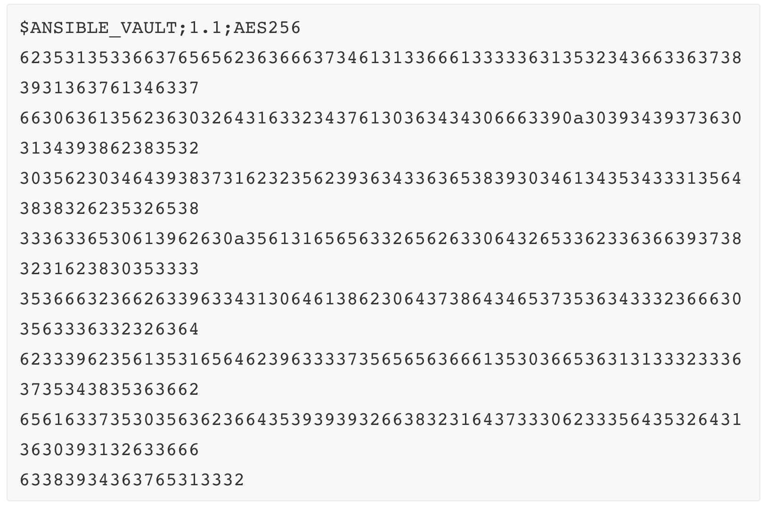
roles/TeamCityAgent/defaults/main.yaml

Slide 111
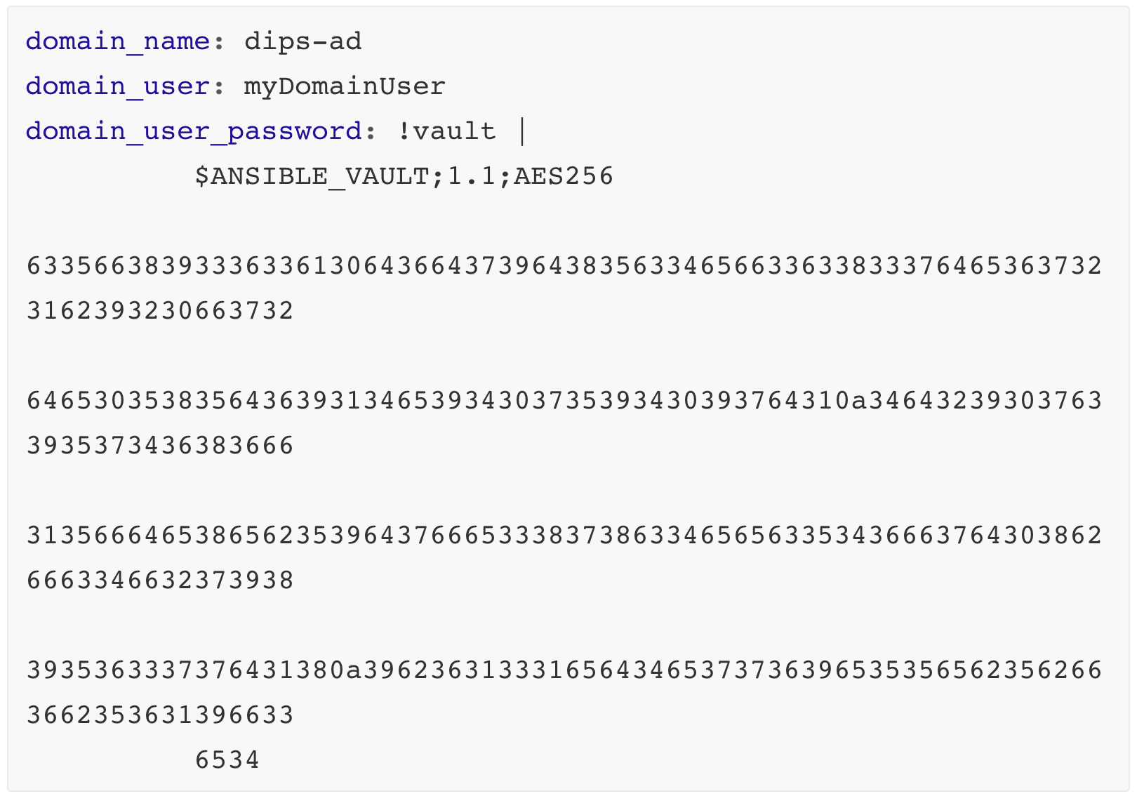
roles/TeamCityAgent/defaults/main.yaml

Slide 112
Exercise 5: Vault and encryptet secrets

